Slide 1
Credit Card Fraud Detection: Capstone Project
By: Prateek Sharma

Slide 2
Index:
Objective
Background
Few Examples on how the Fraud Occurs
Key Findings
Recommendations
Data Sources
Problem Solving Methodology
Dependent Variable
Derive time related and distance related variable
Historical Variable
Correlation
Appendix
Model Development
Business Impact

Slide 3
OBJECTIVE:
Based in Florida, the US, Finex is a top provider of financial services. Through a variety of channels, including in-person banking, ATMs, and online banking, it provides consumers with a comprehensive range of goods and business services.
Due to the sharp rise in fraud transactions in recent years, the company has been experiencing severe problems with sales and profitability.
Retaining highly profitable customers is the primary objective for banking organization's like Finex . However, with the expansion of digital payment methods, financial fraud poses a serious danger to this objective for many banks.
Implementing a system for detecting credit card fraud to reduce costs . Due to scams and a human detection method, significant costs are being paid.
As the consulting firm Finex engaged, our job was to find the main reason behind the problem of unauthorized credit card/debit card transactions and suggest solutions.

Slide 4
BACKGROUND:
Using skimmers on ATM/POS devices, fraudsters steal credit card data and carry out unauthorized transactions.
According to the Federal Trade Commission, 10 million consumers worldwide experience credit card theft each year.
Each year, fraud costs credit card companies close to $50 billion.
These expenses 'trickle down' to all customers as higher interest rates and fees.
Losses from credit card fraud are borne by all cardholders.
Repairing the damage costs the victims both time and money.
To make up for their losses, credit card companies impose increased fees and interest rates.
client loss for the bank.
A machine learning model has been built to detect frauds early and mitigate losses.
A cost benefit analysis has been done for the deployment of the same.

Slide 5
Few examples on how the fraud occurs:
Stolen Card Information: Root Cause: Data Breaches Data breaches involving financial institutions, merchants, or third-party service providers can expose sensitive credit card information. Hackers can then use this information for unauthorized transactions.
Phishing and Social Engineering: Root Cause: Lack of User Awareness Fraudsters use phishing emails, fake websites, or social engineering tactics to trick users into revealing their credit card details. Users who are unaware of these tactics are more likely to fall victim.
Card Skimming and Cloning: Root Cause: Lack of Terminal Security Fraudsters install skimming devices on ATMs or point-of-sale terminals to capture card data. Inadequate terminal security allows these devices to go undetected.
Malware and Hacking: Root Cause: Vulnerable Systems Cyberattacks on financial institutions' systems can lead to unauthorized access and data theft. Outdated software and poor cybersecurity practices can make systems vulnerable.
Inadequate Transaction Analysis: Root Cause: Poor Data Analysis Failure to analyze transaction patterns and anomalies effectively may result in missing fraudulent activities.
Poor Customer Verification: Root Cause: Weak Customer Authentication Institutions that don't adequately verify customer identities can be susceptible to fraudsters posing as legitimate users.
Lack of Data Encryption: Root Cause: Data Exposure Failure to encrypt sensitive customer data during transmission and storage exposes it to potential breaches.

Slide 6
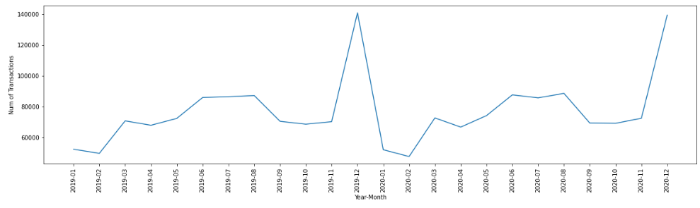
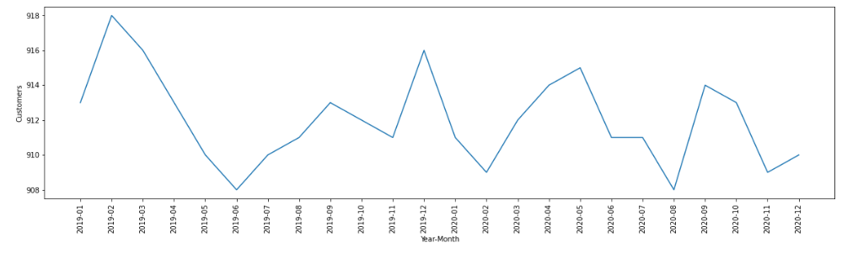
KEY FINDINGS:
YEAR MONTH VS TRANSACTIONS AND CUSTOMERS
The timeline plot displays the total number of transactions and the total number of clients for each month of the year.
Every month, 900 consumers conduct anything between 60k and 140k transactions.
The number of patrons did not vary significantly. It demonstrates that the same consumer base makes multiple purchases, which is a seasonal behavior. The month of December is when we observe a peak.

Slide 7
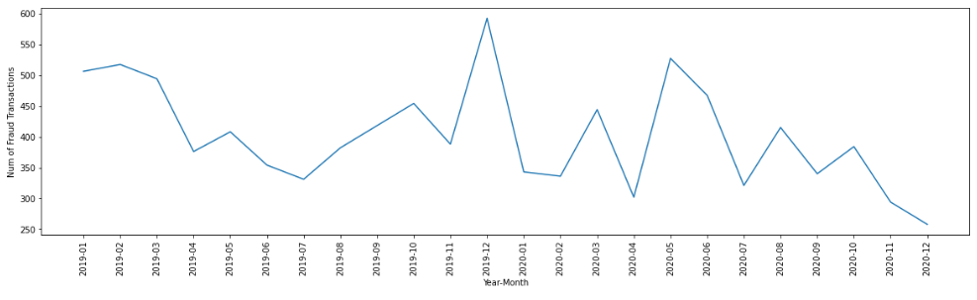
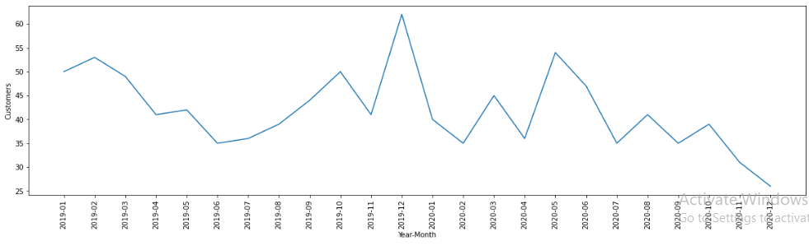
YEAR MONTH VS FRAUD TRANSACTIONS AND CUSTOMERS
Between 250 and 600 purchases are fake. The spread of fraudulent transactions over all months demonstrates that fraud is a persistent tendency.
It's interesting to see that overall transactions reach a peak in December 2020, whilst fraudulent transactions experience a decline.
For example, 500 fraudulent transactions were performed using the same 50 customers' credit cards in January 2019. Fraudulent transactions are repeated for the same consumers' credit cards. Most frequently, the same customer's credit card was used in more than one fraudulent transaction.

Slide 8
CATEGORICAL VARIABLE - GENDER
The number of transactions in both groups does not show much skewness
based on the 'Gender' variable.
In both groups, the fraud rate is roughly the same.
The gender of credit card holders has no bearing on the bias of fraudulent transactions.
 | Gender | Fraud | Count | Gender Count | Percent GRP
0 | F | 0 | 1009850 | 1014749 | 99.517221
1 | F | 1 | 4899 | 1014749 | 0.482779
2 | M | 0 | 832893 | 837645 | 99.432695
3 | M | 1 | 4752 | 837645 | 0.567305

Slide 9
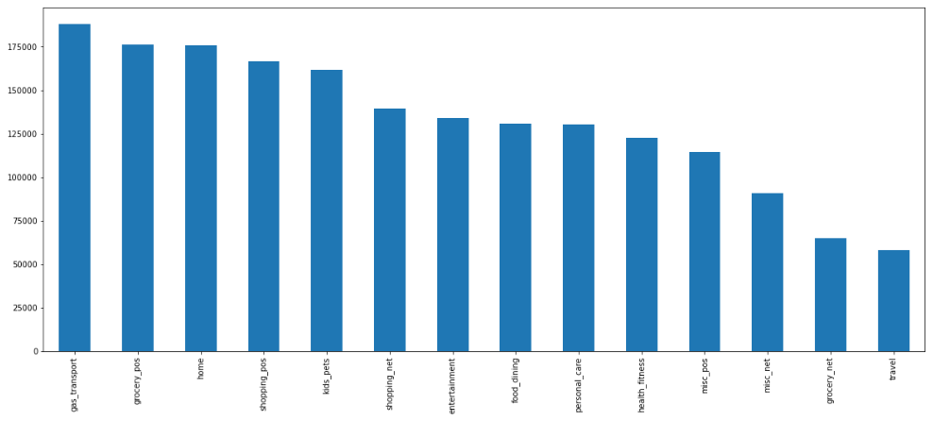
CATEGORICAL VARIABLE – MERCHANT CATEGORY
No. of Transactions of different Merchants
Between the various categories (gas_transport, grocery_pos, trip), there are different numbers of transactions.

Slide 10
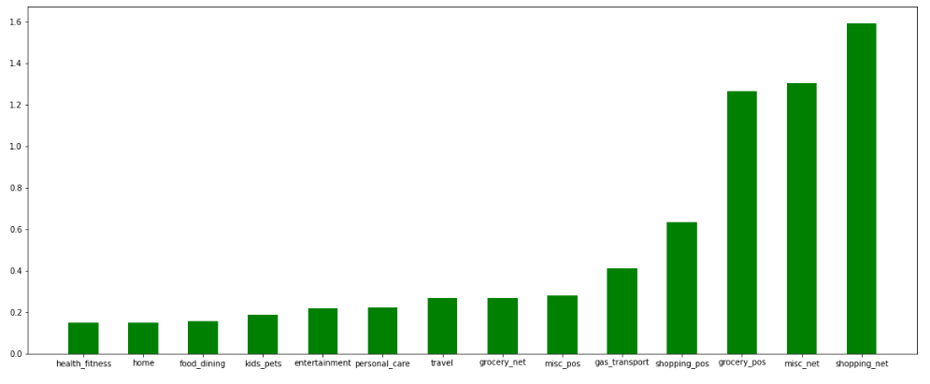
CATEGORICAL VARIABLE – MERCHANT CATEGORY
Fraud Transaction Percentage within different Merchants
In contrast to the category "Shopping_Net," which has a high percentage of fraudulent transactions, the category "Health_Fitness" has a low percentage of such transactions.

Slide 11
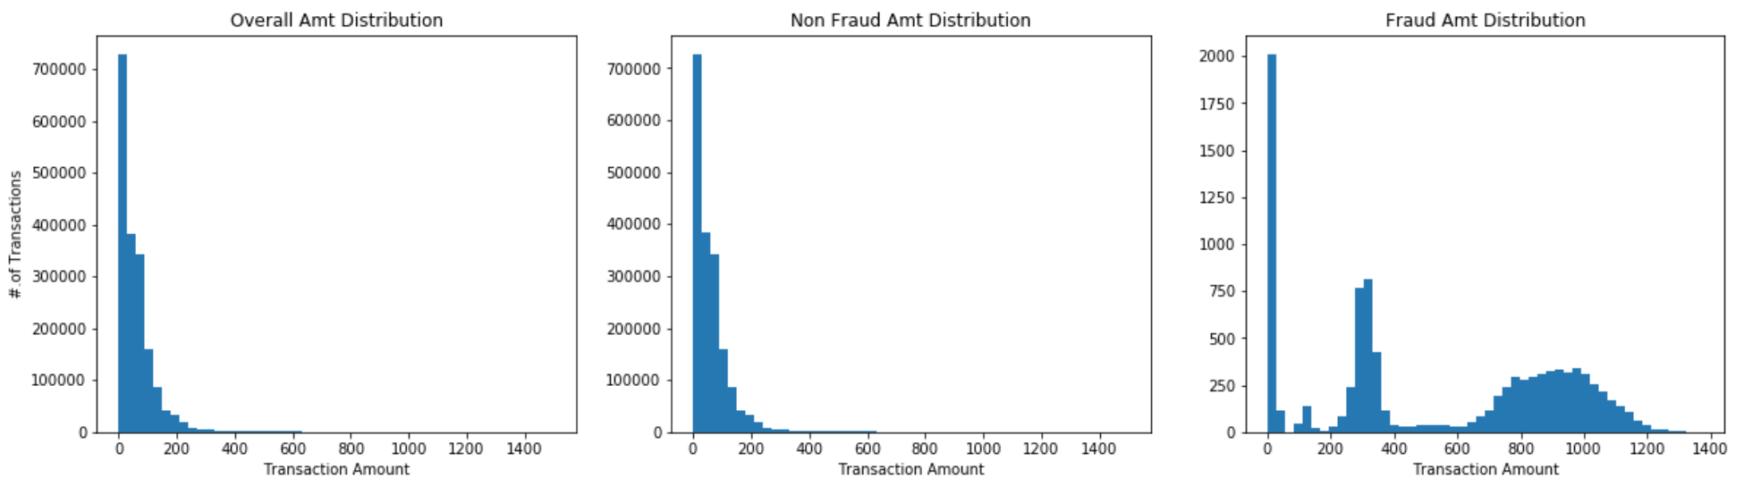
AMOUNT DISTRIBUTION
The "Amt" distribution for fraudulent transactions differs significantly from the "Amt" distribution for all transactions.
The [$1 - $50], [$200 - $400], and [$600 - $1,200] bill value ranges are where the majority of fraudulent transactions occur. Fraudsters tend to concentrate on Transaction Bill Values in the middle of the scale rather than very high-value transactions.

Slide 12
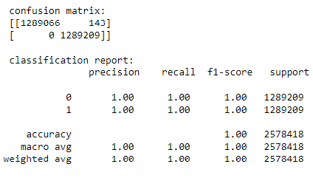
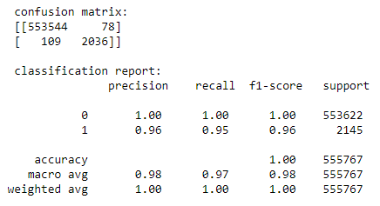
MODEL RESULTS – RANDOM FOREST
Train data Result:
Test data Result:
In comparison to other models, the random forest model has good precision and recall values for both train and test data. Therefore, the forecast will be well-fit by this model.
Note: Precision and recall need to be only evaluated on the minor class that is Fraud (1) in our case.

Slide 13
RECOMMENDATION:
Employ Anomaly Detection Techniques: Implement unsupervised anomaly detection methods to identify transactions that deviate significantly from normal behavior, even if specific fraud patterns are not known.
Utilize Real-time Monitoring: Implement real-time monitoring systems that can analyze transactions as they occur, allowing for immediate detection and prevention of fraudulent activities.
Implement Multi-factor Authentication (MFA): Require multiple forms of verification (e.g., password, fingerprint, one-time code) for transactions to enhance security and prevent unauthorized access.
Enhance Data Encryption: Encrypt sensitive customer data during transmission and storage to prevent data breaches and unauthorized access.
Implement User and Entity Behavior Analytics (UEBA): Utilize UEBA to detect unusual behaviors not only from users but also from entities (e.g., merchants, third-party providers) interacting with the financial system.
Establish Transaction Velocity Limits: Set limits on the number and frequency of transactions to prevent excessive transaction activity that may indicate fraud.
A second layer of verification and the fraudulent transactions that the model missed result in monthly expenses of $11193, which is just 5% of the costs that were experienced before the model was put in place.

Slide 14
DATA SOURCES:
We have a set of simulated credit card transaction data from 1 January 2019 to 31 December 2020 that includes both legitimate and fraudulent purchases. Origin: Kaggle
It includes transactions made with a pool of 800 businesses using the credit cards of 1,000 customers.
A transactional data typically includes information about the buyer, seller, location characteristics, transaction date, time, amount, and whether or not it involves fraud.

Slide 15
PROBLEM SOLVING METHODOLOGY:
Approaches to Solving Issues
The CRISP DM Framework has been used to guide the design of this project's methodology. The framework's numerous stages are shown below in a chronological flow:
Understanding the Business Data
Data preparation and Feature Engineering
Exploratory Data Analytics & Visualization
Preparing Predictive Models & determining important KIP’s
Model Evaluation and Model Selection

Slide 16
DEPENDENT VARIABLE :
The prediction variable on which we base the classification method is referred to as a dependent variable.
The dependent variable in this instance is 'is_fraud', which has values [0,1] and indicates if a transaction is fraudulent or not.
The majority of transactions are legitimate ones. There is a class imbalance issue because there are only 0.52% fraudulent transactions out of 1.8 million total transactions.
Is Fraud | Number of Transaction | % of Transaction
0 | 18,42,743 | 99.48
1 | 9,651 | 0.52

Slide 17
DERIVE TIME RELATED AND DISTANCE RELATED VARIABLES:
'Transaction date time' is a variable in all transactional data. Numerous variables that can be used as features in 0the model and in data analysis can be derived from this.
The following variables were obtained from our existing data model:
Date
Year Month
Day of Week
Hour of the Day
Using the consumer and retailer location characteristics, the "haversine distance" is calculated.

Slide 18
HISTORICAL VARIABLES:
The Customer ID is used as the pivot key for the historical variables that were calculated.
The following are descriptions of the variables:
Transactions made by the customer in the previous 60 days, excluding the day of the transactions.
Average order value for customers over the previous 60 days, excluding the day of the transactions.
Transactions made by the customer in the last 24 hours prior to the current transactions.
The amount of fraudulent transactions made by customers in the last 24 hours, excluding those made in the previous 2 hours because, in real time, it often takes 2 hours for clients to discover fraudulent transactions, file a complaint with the bank, and for the data to be registered into the data store or table.

Slide 19
CORRELATION:
To understand how the dependent variable is impacted by the independent variables, it is crucial to understand the correlation between the dependent and independent variables.
The dependent variable "Is Fraud" and the independent variable "Historical Fraud Transactions in the last 24 Hours" are 77% associated, indicating that credit card thieves who steal information make numerous transactions quickly.

Slide 20
APPENDIX:
From the bank's perspective, there are typically 77183 transactions per month.
An average of 402 fraudulent transactions occur each month.
$531 on average per fraudulent transaction
Costs associated with earlier illegal transactions: 531 * 402 = $213462.
After the model is created and used, the monthly cost is $ 11193.
Costs incurred prior to and following the change equal 213462 - 11193, which is 202269 (94.76% savings!).

Slide 21
MODEL DEVELOPMENT:
On the basis of the following 29 features, various ML models are developed:
Features at the transactional level (Amt, Time, Category, Gender, etc.)
The features of categories are one-hot encoded.
past characteristics of customers
features of distance
The following measures are used to assess the performance of the model:
Instead of striving for total data set accuracy, recall (the ability to identify the majority of fraud cases) and precision (the ability to identify the majority of fraud cases in transactions) are more crucial.
Additionally, we must evaluate how the model performs on test and train sets. Based on the chosen measures, we must make sure that the model performs similarly on both.

Slide 22
Business Impact:
Credit card fraud detection has a significant business impact on financial institutions, customers, and the overall economy. Here are some key ways in which effective credit card fraud detection influences various stakeholders:
1)Financial Institutions:
Cost Savings: Successful fraud detection prevents financial losses resulting from unauthorized transactions, reducing the need to reimburse customers for stolen funds.
Customer Retention: By demonstrating a commitment to security, financial institutions can retain customer trust and loyalty, leading to long-term relationships and increased customer lifetime value.
Reputation Management: Effective fraud prevention enhances the institution's reputation as a secure and reliable provider of financial services, attracting new customers and maintaining positive word-of-mouth.
Regulatory Compliance: Fraud detection measures help financial institutions meet regulatory requirements and security standards, avoiding penalties and legal consequences.

Slide 23
2. Customers:
Financial Security: Customers benefit from reduced risk of their funds being stolen or misused, enhancing their confidence in using credit cards for transactions.
Peace of Mind: Knowing that their transactions are being monitored for fraud helps customers feel at ease while making online or offline purchases.
Convenience: Successful fraud detection minimizes disruptions caused by declined transactions due to false positives, ensuring smoother shopping experiences.
Reduced Hassle: When fraud is detected early, customers are spared the time and stress required to resolve unauthorized transactions.
3. Economy:
Consumer Spending: Effective fraud detection boosts consumer confidence in online and electronic transactions, leading to increased spending, which is beneficial for the economy.
E-commerce Growth: Secure online transactions encourage e-commerce growth by fostering trust between buyers and sellers.
Financial Stability: By preventing financial losses and maintaining the credibility of financial systems, fraud detection contributes to the overall stability of the economy.

Slide 24
4. Industry Reputation:
Trust in Financial Services: The collective effort of financial institutions to combat fraud enhances the reputation of the financial services industry as a whole, inspiring trust among the public.
Innovation and Growth: With confidence in the security of electronic transactions, individuals and businesses are more likely to adopt innovative financial technologies and solutions.
5. Fraud Prevention Industry:
Market Growth: The demand for advanced fraud prevention technologies and services drives growth in the fraud detection industry, creating new business opportunities.
Technological Innovation: The need for more sophisticated detection methods spurs innovation in machine learning, artificial intelligence, and cybersecurity.
In summary, effective credit card fraud detection has far-reaching implications for financial institutions, customers, the broader economy, and the financial services industry. By safeguarding transactions and maintaining trust, fraud detection supports financial stability, economic growth, and customer satisfaction. It also encourages innovation and collaboration within the industry to stay ahead of evolving fraud tactics.

Slide 25
THE END!!!

